Slide 1






SuperWiser
Your AI Research Supervisor Assistant
Yarden Adi, Rom Himelstein and Eyal Tadmor
January 30, 2025

Slide 2



Problem
Students (especially new ones) have a hard time finding research supervisors.
Crafting the first email and CV is daunting.
Traditional methods are:
Confusing
Time-consuming
These barriers can delay progress and discourage research pursuits.

Slide 3
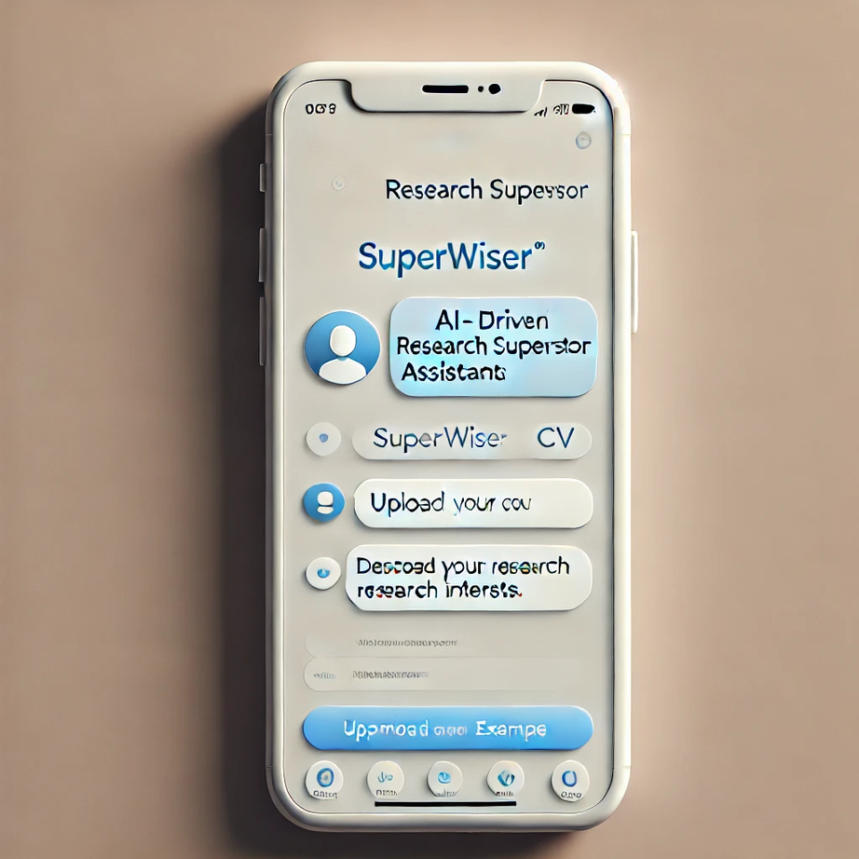


Solution: SuperWiser
A user-friendly chatbot for seamless interaction.
Accepts user preferences and a CV draft.
Recommends suitable research supervisors.
Generates a tailored email draft and polished CV.
Ensures CV accuracy, avoiding any misleading information.

Slide 4





Data Sources
Technion Faculty Website
Semantic Scholar API
Student Reviews
Collect faculty names, contact details, and departmental information (initially DDS portal, expanding to other departments like CS and ECE).
Retrieve 20 recent publications per faculty member, including titles, dates, and abstracts where available.
Gather feedback on supervision experiences from accessible sources (mainly students) to enhance matching accuracy.

Slide 5


Tasks the Agent will Perform
CV Parser: Parses and processes student CVs.
RAG Agent: Matches students with the best supervisor using CV and user inputs.
CV Generator: Creates an enhanced CV tailored for the recommended supervisor.
Feedback Agent: Validates CV and email for accuracy and consistency.
Email Formulator: Drafts a professional email for the supervisor, incorporating CV and student details.

Slide 6
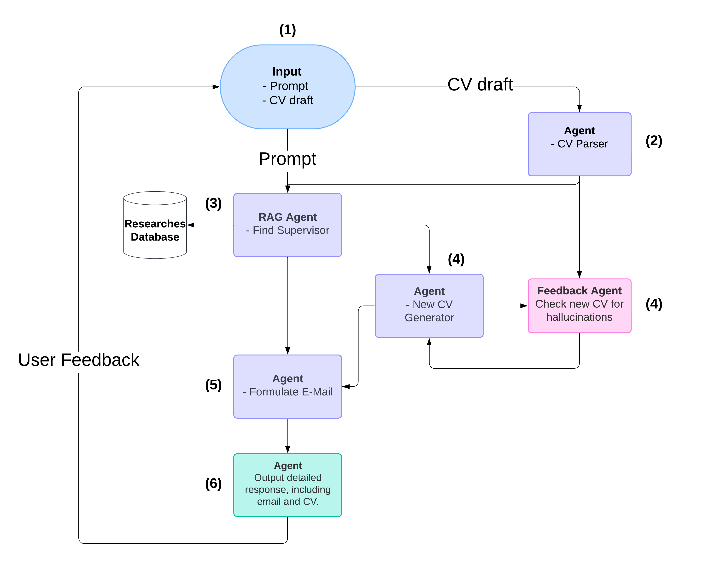


Agent Flow

